Slide 1

COVID-19 Gene Sequencing and Twitter Data Analysis
Kieu Cheung
Flatiron Schools Oct 28th, 2020

Slide 2
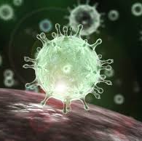
Introduction
The virus then travels to the lungs and causes the lungs to become inflamed and fill with fluid. This results in a reduction of the oxygen supply to the bloodstream. If oxygen levels in the bloodstream decrease, the heart works harder to supply organs and the rest of the body with enough oxygen to function. Pneumonia can progress to respiratory failure, which why a person may need a ventilator to help them breathe.
Coronaviruses are members of the subfamily Coronavirinae. Sequence analysis of SARS-CoV-2 isolates suggests that the 30-kb genome encodes as many as 29 proteins though not all of them are expressed. Coronaviruses possess the largest genomes (26.4–31.7 kb) among all known RNA viruses.
The virus spread from person to person mainly through respiratory droplets produced when an infected person coughs or sneezes. Currently, there is no vaccine for the disease. To date, quarantine and social distancing are the most effective strategies to keep people safe. However, these strategies do not come at no cost. There are legal and ethical challenges, such as should the government’s right to interfere in such areas as faith and family affairs like gatherings for funerals at the same time protecting the vulnerable individuals?
Project Goals:
1. RNA sequencing with Biopython
2. Mutation Identifications : Has the virus mutated?
3. Twitter Data Analysis: What other topic related to Covid-19 people tweet about? Can a machine learning model categorize topics related to Covid-19?
A visualization of the SARS virus. It is a type of coronavirus and displays the coronavirus' signature crownlike appearance under a microscope.
Image credit to 3D4Medical / Science Source

Slide 3
Data Sources
6 SAR-CoV-2 virus sequences come from NCBI database:
The sequence IDs "MN988713" and "MN996531" collected in early January 2020.
The sequence IDs "MT375466" and "MT642425" collected in April 2020.
The sequence IDs "MW006554" and "MW031050" collected in September 2020.
Twitter API: 20,075 tweets related to Covid-19

Slide 4
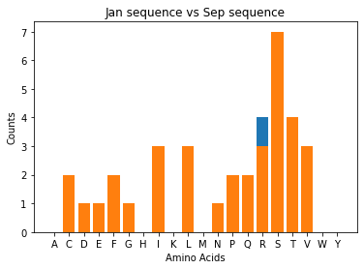
Gene sequencing: DNA→RNA→ Protein DNA: made up of 4 bases: Adenine, Thymine, Cytosine, and Guanine RNA: made up of 4 bases: Adenine, Uracil, Cytosine, and Guanine Protein: made of 20 amino acids: A, R, C, D, E, F, G, H, I, K, L, M, N, P, Q, R, S, T, V, W, Y - 8 potential mutations detected. Euro Surveill. 2020 Apr 2; 25(13): 2000305 reports 8 missense mutations - The Jan sequence and Sep sequence are different by 1 amino acid, arginine ( R ) as shown in blue.

Slide 5
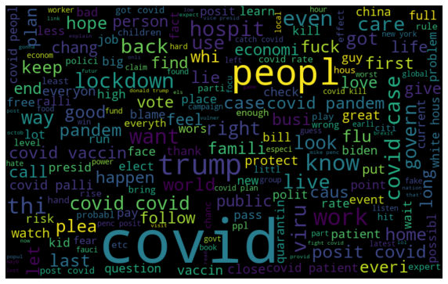
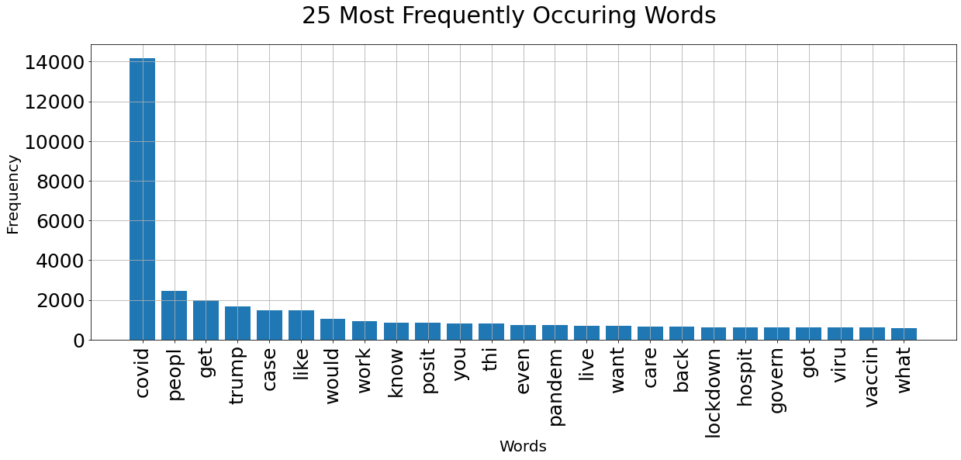
What people tweet about related to COVID-19?

Slide 6
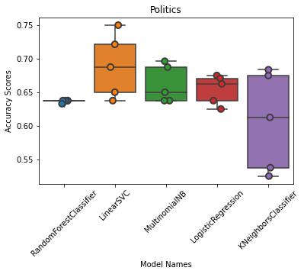
Machine Learning Models & Performance
KNeighborsClassifier 0.61
LinearSVC 0.69
LogisticRegression 0.65
MultinomialNB 0.66
RandomForestClassifier 0.64

Slide 7
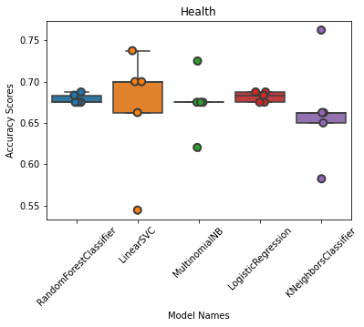
Machine Learning Models & Performance
KNeighborsClassifier 0.66
LinearSVC 0.67
LogisticRegression 0.68
MultinomialNB 0.67
RandomForestClassifier 0.68

Slide 8
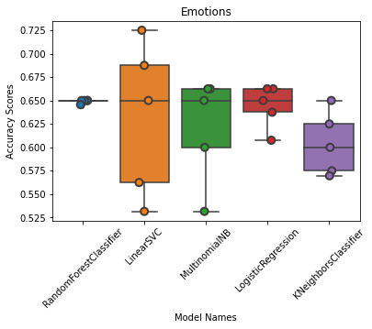
Machine Learning Models & Performance
KNeighborsClassifier 0.60
LinearSVC 0.63
LogisticRegression 0.64
MultinomialNB 0.62
RandomForestClassifier 0.65

Slide 9
Example: How Random Forest Model Labels an Unlabeled Tweet
Input | "Dear USA, people please save the usps and stay "\ "covid safe by directly dropping off your ballots "\ "to county election offices. Vote please!”
Text after tokenizing | “Dear USA, people please save the usps and stay covid safe by directly dropping off your ballots to county election offices. Vote please! usa people please usps ballots election vote please”
Output | array([1])
Note: | “0” means not in the politics category & “1” means in the politics category

Slide 10

Future Works
Continue monitoring the COVID-19 RNA to see if there are more mutations
Re-train the models with more Twitter data
Collect Twitter data after the election to see if the topics surrounding COVID-19 might have changed and use the models for labeling
Image source: https://www.ideal-ist.eu

Slide 11

THANK YOU!
Special thanks to my cohort instructor Abhineet Kulkarni, fellow students at Flatiron Schools!

